Slide 1
Credit Fraud Detection
Prepared by:
Aslı Yılmaz
Senih Erdem
Çağrı Tapan
Yunus Kara

Slide 2
Introduction
In 2015, $21.84 billion was fraudulent transaction among all credit card transactions.
Models can create by machine learning in order to predict possible credit card frauds.
We aim to create such model to differentiate small and significant amount of fraudulent transactions from large amounts of everyday transactions.

Slide 3
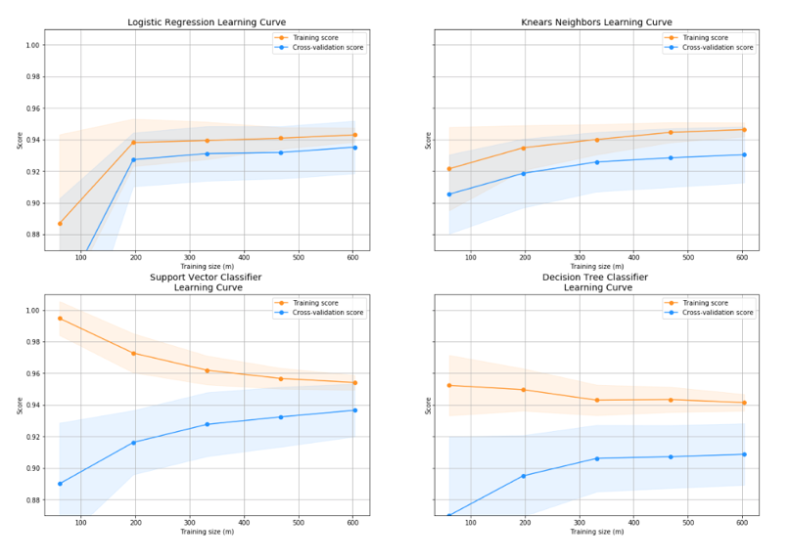
Methods & Tools of Use
Classifiers: LogisticRegression Has a training score of 93.0 % accuracy score
Classifiers: KNeighborsClassifier Has a training score of 93.0 % accuracy score
Classifiers: SVC Has a training score of 94.0 % accuracy score
Classifiers: DecisionTreeClassifier Has a training score of 90.0 % accuracy score
Logistic Regression Cross Validation Score: 93.92%
Knears Neighbors Cross Validation Score 92.99%
Support Vector Classifier Cross Validation Score 94.05%
DecisionTree Classifier Cross Validation Score 89.55%

Slide 4
Methods Review & Background
Logistic Regression: the dependent variable is a binary variable that contains data coded as 1 (yes, success, etc.) or 0 (no, failure, etc.)
Our output that we test based on 1 or 0 value. Fraud transactions are “fraud=0” and non-fraud transactions are “fraud=1”.
True Positives (TP), True Negatives (TN), False Positives (FP), and False Negatives (FN)
Model evaluation metrics: Accuracy, Precision, Recall, F1 Score

Slide 5
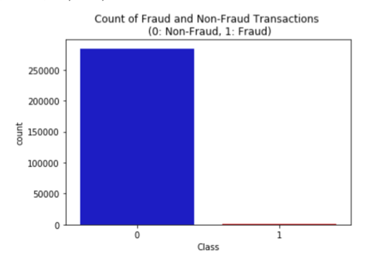
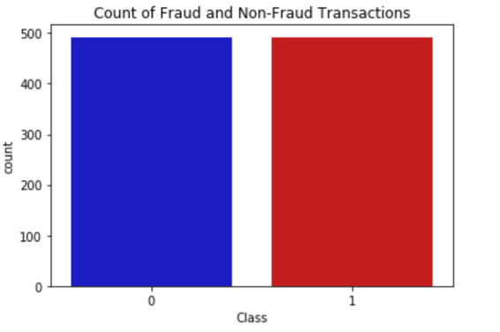
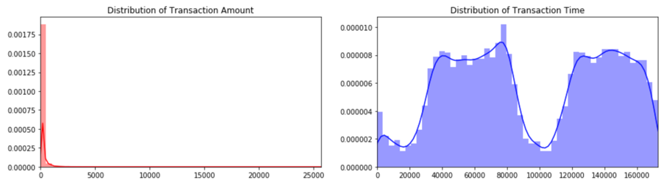
Data Cleaning & Restructuring
There are 284,807 transactions in total and 492 of them are classified as fraud (positive class).
The dataset comprises of 30 features, but due to the data confidentiality reasons, features are named as V1, V2, …, V28, except the amount and time.
The number of fraud transactions are almost at a negligible level compared to the non-fraud transactions.
By having an unbalanced dataset, it is not possible to see the true correlations between the classes and features. To overcome these overfitting and wrong correlation issues, we use Random Under-Sampling technique to have a dataset with a 50/50 ratio of fraud and non-fraud transactions.

Slide 6
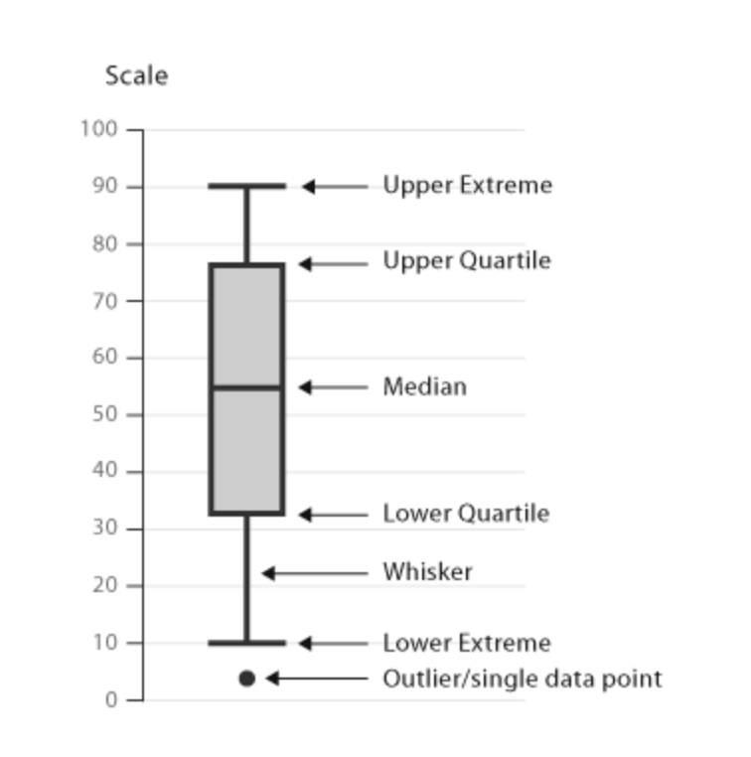
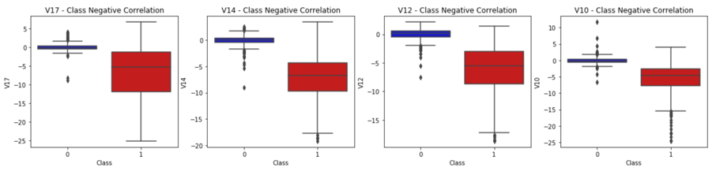
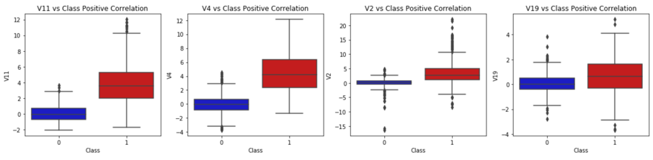
Statistical Analysis & Data Exploration
In order to explore our sub-sampled data more deeply, we first construct a correlation matrix between the features
V17, V14, V12 and V10 are negatively correlated with the Class.
V2, V4, V11, and V19 are positively correlated.
To detect anomalies and have a positive impact on the accuracy of our models, we remove extreme outliers from features that have a high correlation with our classes. First, we apply Interquartile Range (IQR) method which will be calculated by the difference between the 75thpercentile and 25thpercentile so that we can create a threshold beyond the 75thand 25thpercentile and if an instance passes this threshold, it will be deleted.

Slide 7
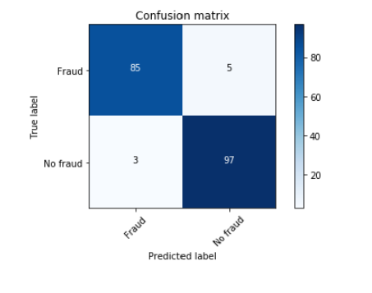
Results
Dataset split ratio 80/20
Logistic Regression classifier
Accuracy: 0.947
Recall: 0.9444
F1 Score: 0.955

Slide 8
Resources & References
Related Links:
https://becominghuman.ai/logistic-regression-in-python-from-scratch-954c0196d258
https://github.com/martinpella/logistic-reg/blob/master/logistic_reg.ipynb
https://www.kaggle.com/janiobachmann/credit-fraud-dealing-with-imbalanced-datasets

